Slide 1
Boolean Algebra

Slide 2
Boolean Algebra
Algebraic Structure: Defined as set of elements, a set of operators and a number of unproved axioms or postulates.
Boolean Algebra- George Boole in 1854
Switching Algebra ( Two valued Boolean Algebra) – Shanon in 1938
Postulates formulated –Huntington in 1904

Slide 3
Common postulates to formulate various algebraic structures
Closure
A Set S is closed, if for every pair of elements of S, the binary operator specified a rule for obtaining a unique element of S.
Associative law
(x*y)*z = x*(y*z) for all x, y, z in S
Commutative law
x * y = y * x for all x, y in S
Identity element
e * x = x * e = x for every x in S
Inverse
x * y = e => y is the inverse of x and vice versa
Distributive law
x * (y•z) = (x * y) • (x * z)

Slide 4
Huntington Postulates
Boolean algebra is an algebraic structure defined on a set of elements B together with two binary operators + and • provided the following postulates are satisfied
Closure with respect to + and •
Identity element: x + 0 = 0 + x = x; x •1 = 1 •x = x
Commutative: x + y = y + x; x • y = y • x
Distributive: (• over +: x • (y + z) = (x • y) + (x • z)) (+ over •: x + (y • z) = (x + y) • (x +z))
Complement: X + = 1 and x • = 0
There exists at least two elements x, y Є B such that x ≠ y

Slide 5
Comparison of Boolean algebra and ordinary algebra
Huntington postulates | Ordinary algebra
Do not include associative law | Holds associative law
+ over • distributive law is valid | + over • distributive law is invalid
Does not have additive and multiplicative inverses (hence no subtraction & division) | Additive and multiplicative inverse exists
Complement exists | Complement is not available
Finite set of elements | Real numbers

Slide 6
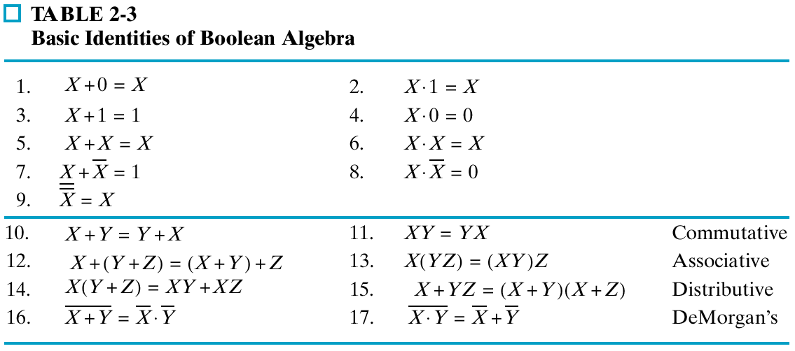
Basic Theorems
18. x+xy =x 19. x(x+y) = x Absorption

Slide 7
Duality
To obtain the dual of an algebraic expression, interchange OR and AND operators and replace 1’s by 0’s and 0’s by 1’s.
the dual of an expression does not equal the expression itself.
Example: F = (A + C) · B + 0
dual F = (A · C + B) · 1 = A · C + B
Example: G = X · Y + (W + Z)
dual G = (X + Y) . (W . Z)
Example: H = A · B + A · C + B · C
dual H = A + B . A + C . B + C

Slide 8
Boolean Operator Precedence
The order of evaluation in a Boolean expression is:
Parenthesis
NOT
AND
OR
Example: F = A(B + C)(C + D)

Slide 9
Complementing Functions
Use DeMorgan's Theorem to complement a function:
1. Interchange AND and OR operators
2. Complement each constant value and literal
Example: Complement F =
F = (x + y’ + z)(x’ + y + z)
DeMorgan’s Theorem can be extended to 3 or more variables
x
y
z
+
x
y
z

Slide 10
Complement
Simple procedure:
- Dual of the function and complementing each literal.
Eg: F1 = x’yz’+x’y’z
dual of F1 = (x’+y+z’).(x’+y’+z)
F1’ = (x+y’+z).(x+y+z’)

Slide 11
Complement
Find the duality and complement of the function
(BC’+A’D)(AB’+CD’)

Slide 12
References
M. Morris Mano – Digital Logic and Computer Design PHI – 5th Edition- 2004. pp. 18, 20, 25 – 29

